Slide 1

Chapter 4: Project Integration Management
Information Technology Project Management, Seventh Edition
Note: See the text itself for full citations.

Slide 2
Project Management Institute: Overview
Possible Certifications & Career Paths – Resources- Guidelines-Relationship to ITPM Course

Slide 3
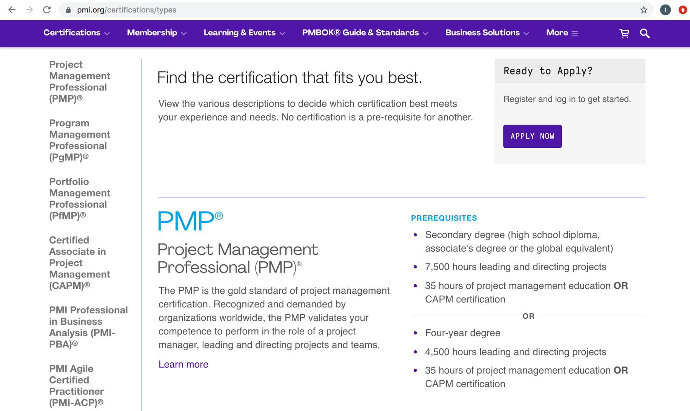
Project Management Institute (PMI): Certification Examples

Slide 4
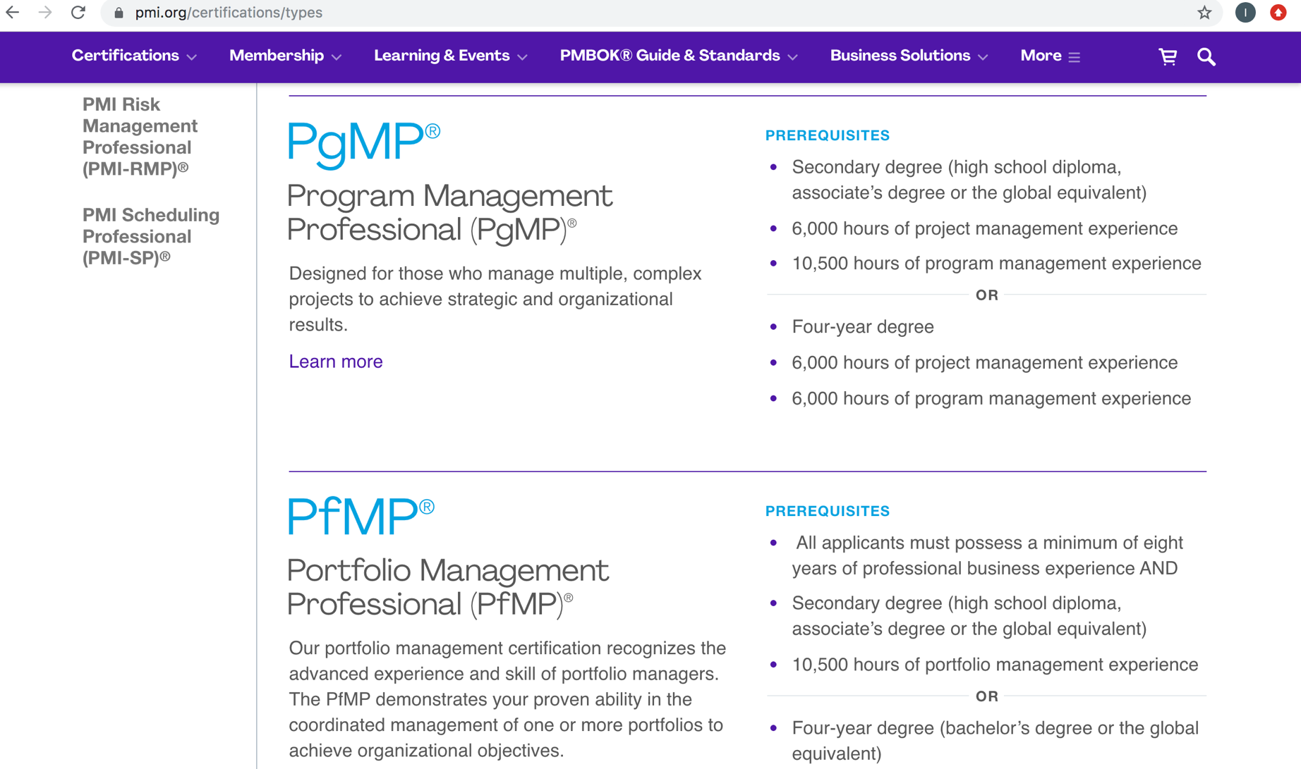
Project Management Institute (PMI): Certification Examples

Slide 5
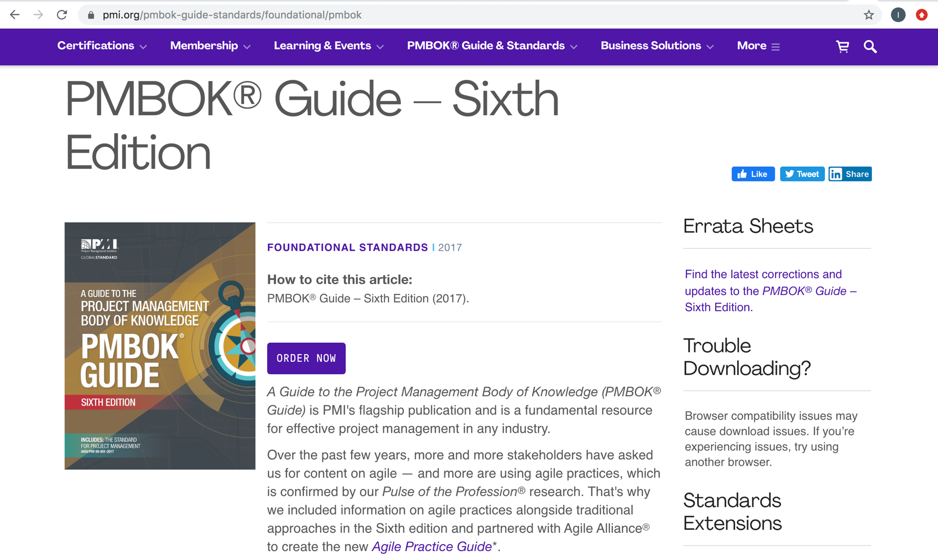
Project Management Institute: Project Management Body of Knowledge Guide (PMBOK)

Slide 6
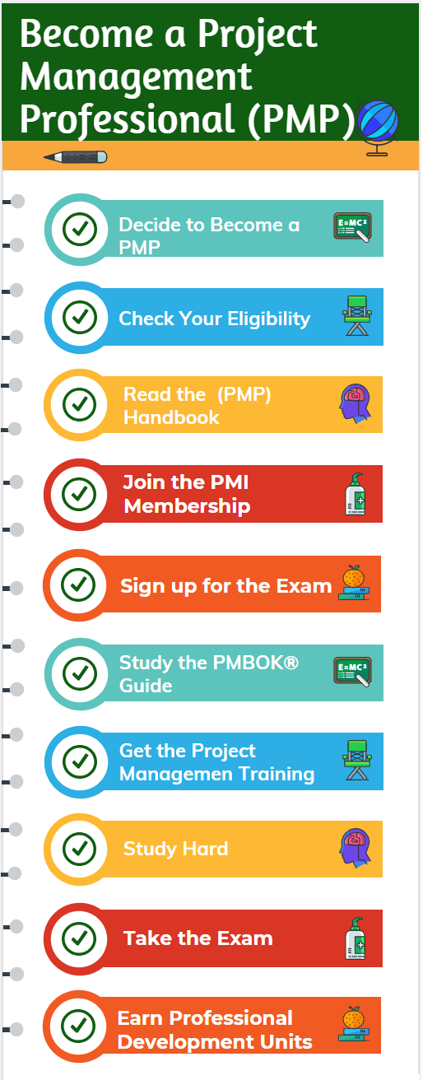

Slide 7
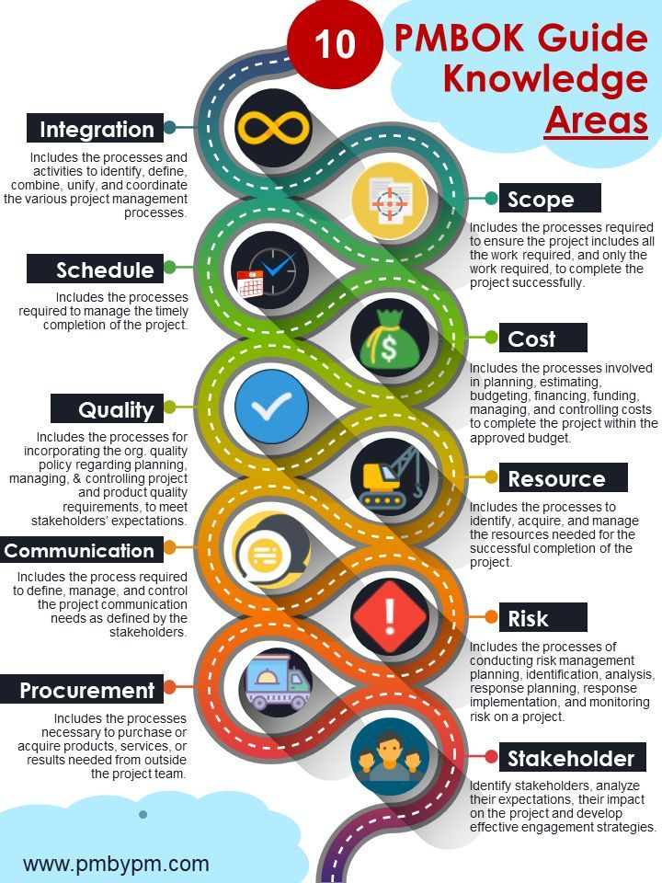

Slide 8
Chapter 4: Project Integration Management
Information Technology Project Management, Seventh Edition
Note: See the text itself for full citations.

Slide 9
Learning Objectives
Describe an overall framework for project integration management as it relates to the other project management knowledge areas and the project life cycle
Discuss the strategic planning process and apply different project selection methods
Explain the importance of creating a project charter to formally initiate projects
Describe project management plan development, understand the content of these plans, and review approaches for creating them

Slide 10
Learning Objectives
Explain project execution, its relationship to project planning, the factors related to successful results, and tools and techniques to assist in directing and managing project work
Describe the process of monitoring and controlling a project
Understand the integrated change control process, planning for and managing changes on information technology (IT) projects, and developing and using a change control system
Explain the importance of developing and following good procedures for closing projects
Describe how software can assist in project integration management

Slide 11
The Key to Overall Project Success: Good Project Integration Management
Project managers must coordinate all of the other knowledge areas throughout a project’s life cycle
Many new project managers have trouble looking at the “big picture” and want to focus on too many details
Project integration management is not the same thing as software integration

Slide 12
Project Management Process Groups
A process is a series of actions directed toward a particular result
Project management can be viewed as a number of interlinked processes
The project management process groups include
initiating processes
planning processes
executing processes
monitoring and controlling processes
closing processes

Slide 13
Project Integration Management Processes
Developing the project charter involves working with stakeholders to create the document that formally authorizes a project—the charter.
Developing the project management plan involves coordinating all planning efforts to create a consistent, coherent document—the project management plan.
Directing and managing project work involves carrying out the project management plan by performing the activities included in it.

Slide 14
Project Integration Management Processes (cont’d)
Monitoring and controlling project work involves overseeing activities to meet the performance objectives of the project
Performing integrated change control involves identifying, evaluating, and managing changes throughout the project life cycle.
Closing the project or phase involves finalizing all activities to formally close the project or phase.

Slide 15
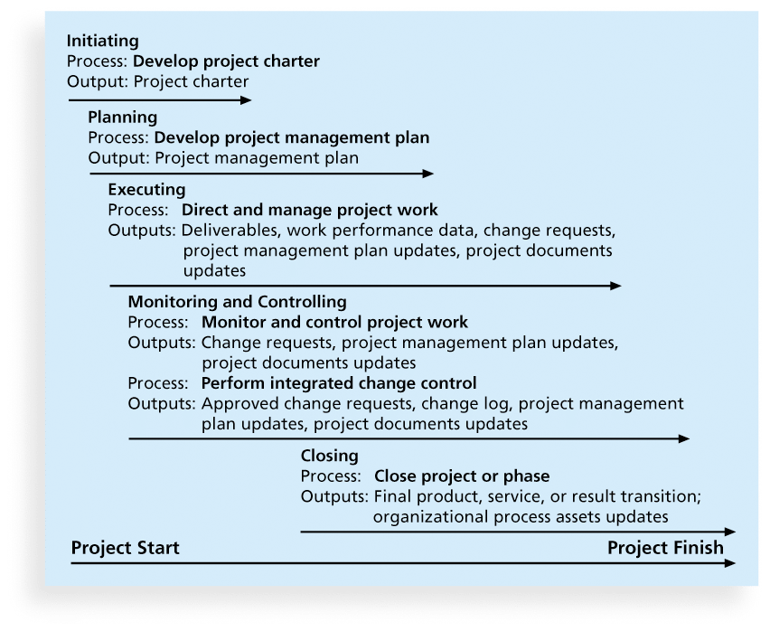
Figure 4-1. Project Integration Management Summary

Slide 16
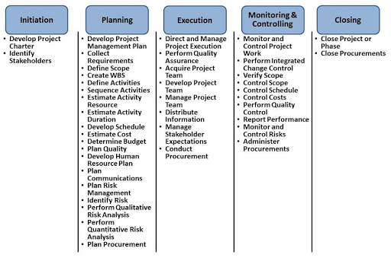
Examples

Slide 17
Strategic Planning and Project Selection
Strategic planning involves determining long-term objectives, predicting future trends, and projecting the need for new products and services
Organizations often perform a SWOT analysis
analyzing Strengths, Weaknesses, Opportunities, and Threats
As part of strategic planning, organizations
identify potential projects
use realistic methods to select which projects to work on
formalize project initiation by issuing a project charter

Slide 18
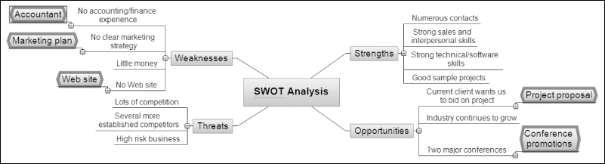
Figure 4-2. Mind Map of a SWOT Analysis to Help Identify Potential Projects

Slide 19
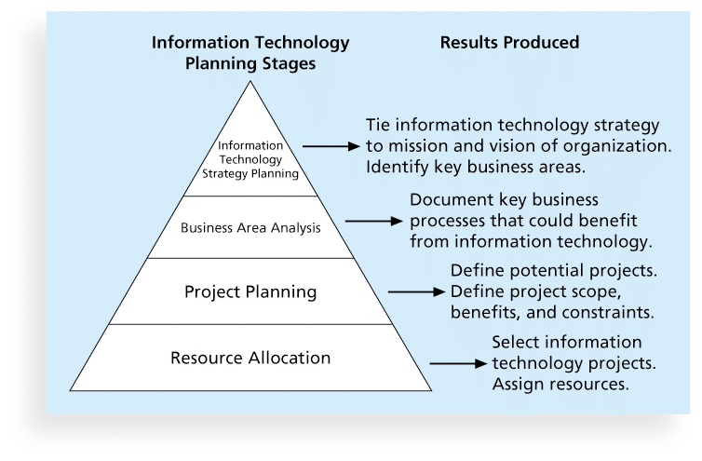
Figure 4-3. Information Technology Planning Process

Slide 20
Best Practice
Only one in seven product concepts comes to fruition. Why is it that some companies, like Proctor & Gamble, Johnson and Johnson, Hewlett Packard, and Sony are consistently successful in New Product Development (NPD)?
Because they use a disciplined, systematic approach to NPD projects based on best practices
Four important forces behind NPD success include the following:
A product innovation and technology strategy for the business
Resource commitment and focusing on the right projects, or solid portfolio management
An effective, flexible and streamlined idea-to-launch process
The right climate and culture for innovation, true cross-functional teams, and senior management commitment to NPD

Slide 21
Methods for Selecting Projects
There are usually more projects than available time and resources to implement them
Methods for selecting projects include:
focusing on broad organizational needs
categorizing information technology projects
performing net present value or other financial analyses
using a weighted scoring model
implementing a balanced scorecard

Slide 22
Focusing on Broad Organizational Needs
It is often difficult to provide strong justification for many IT projects, but everyone agrees they have a high value
“It is better to measure gold roughly than to count pennies precisely”
Three important criteria for projects:
There is a need for the project
There are funds available
There’s a strong will to make the project succeed

Slide 23
Categorizing IT Projects
One categorization is whether the project addresses
a problem
an opportunity, or
a directive
Another categorization is how long it will take to do and when it is needed
Another is the overall priority of the project

Slide 24
Financial Analysis of Projects
Financial considerations are often an important consideration in selecting projects
Three primary methods for determining the projected financial value of projects:
Net present value (NPV) analysis
Return on investment (ROI)
Payback analysis

Slide 25
Net Present Value Analysis
Net present value (NPV) analysis is a method of calculating the expected net monetary gain or loss from a project by discounting all expected future cash inflows and outflows to the present point in time
Projects with a positive NPV should be considered if financial value is a key criterion
The higher the NPV, the better

Slide 26
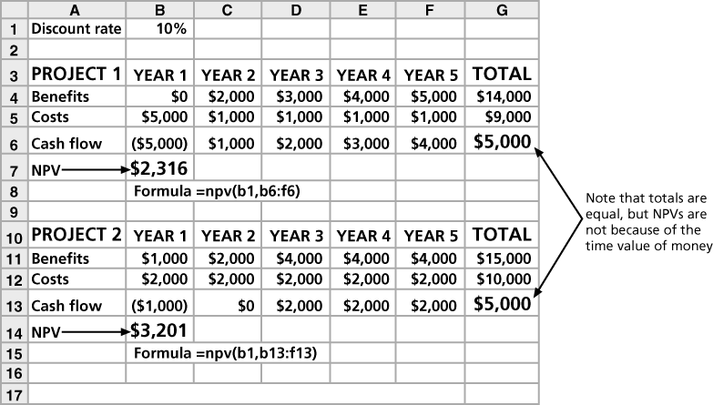
Figure 4-4. Net Present Value Example

Slide 27
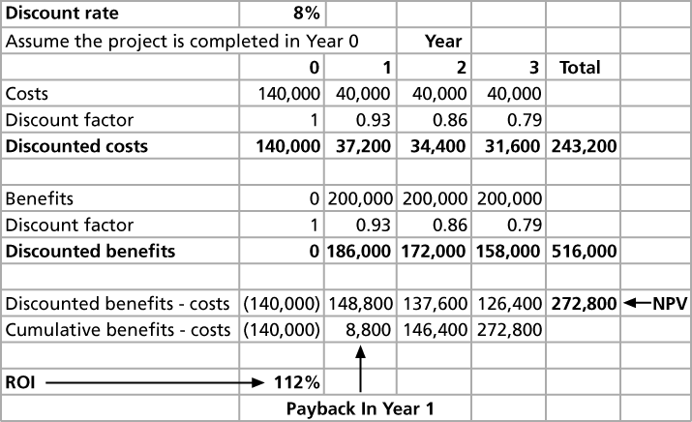
Figure 4-5. JWD Consulting NPV Example
Note: See the template called business_case_financials.xls

Slide 28
NPV Calculations
Determine estimated costs and benefits for the life of the project and the products it produces
Determine the discount rate (check with your organization on what to use)
Calculate the NPV (see text for details)
Notes: Some organizations consider the investment year as year 0, while others start in year 1. Some people entered costs as negative numbers, while others do not. Check with your organization for their preferences

Slide 29
Return on Investment
Return on investment (ROI) is calculated by subtracting the project costs from the benefits and then dividing by the costs
ROI = (total discounted benefits - total discounted costs) / discounted costs
The higher the ROI, the better
Many organizations have a required rate of return or minimum acceptable rate of return on investment for projects
Internal rate of return (IRR) can by calculated by finding the discount rate that makes the NPV equal to zero

Slide 30

Return on Investment

Slide 31
Payback Analysis
Another important financial consideration is payback analysis
The payback period is the amount of time it will take to recoup, in the form of net cash inflows, the total dollars invested in a project
Payback occurs when the net cumulative discounted benefits equals the costs
Many organizations want IT projects to have a fairly short payback period

Slide 32
Payback Analysis
The payback period is the amount of time required for cash inflows generated by a project to offset its initial cash outflow. There are two ways to calculate the payback period, which are:
Averaging method. Divide the annualized expected cash inflows into the expected initial expenditure for the asset. This approach works best when cash flows are expected to be steady in subsequent years.
Subtraction method. Subtract each individual annual cash inflow from the initial cash outflow, until the payback period has been achieved. This approach works best when cash flows are expected to vary in subsequent years. For example, a large increase in cash flows several years in the future could result in an inaccurate payback period if using the averaging method.

Slide 33
Example of the Payback Method
Averaging method: ABC International expends $100,000 for a new machine, with all funds paid out when the machine is acquired. Over each of the next five years, the machine is expected to require $10,000 of annual maintenance costs, and will generate $50,000 of payments from customers. The net annual positive cash flows are therefore expected to be $40,000. When the $100,000 initial cash payment is divided by the $40,000 annual cash inflow, the result is a payback period of 2.5 years. (Initial Cash Payment/ Annual Cash Flow)
Subtraction method: Take the same scenario, except that the $200,000 of total positive cash flows are spread out as follows:
Year 1 = $0 Year 2 = $20,000 Year 3 = $30,000 Year 4 = $50,000 Year 5 = $100,000
In this case, we must subtract the expected cash inflows from the $100,000 initial expenditure for the first four years before completing the payback interval, because cash flows are delayed to such a large extent.
Thus, the averaging method reveals a payback of 2.5 years, while the subtraction method shows a payback of 4.0 years.

Slide 34
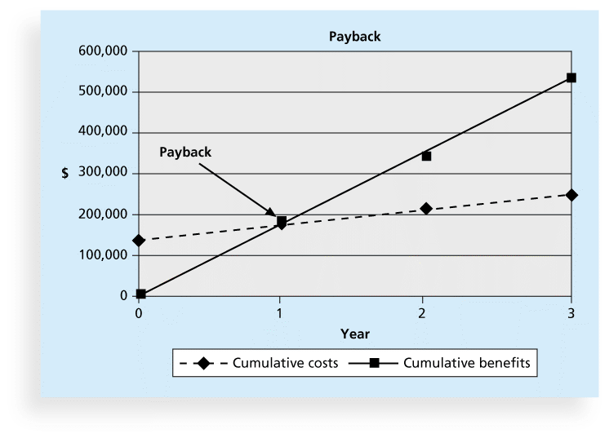
Figure 4-6. Charting the Payback Period

Slide 35
Weighted Scoring Model
A weighted scoring model is a tool that provides a systematic process for selecting projects based on many criteria
Identify criteria important to the project selection process
Assign weights (percentages) to each criterion so they add up to 100%
Assign scores to each criterion for each project
Multiply the scores by the weights and get the total weighted scores
The higher the weighted score, the better

Slide 36
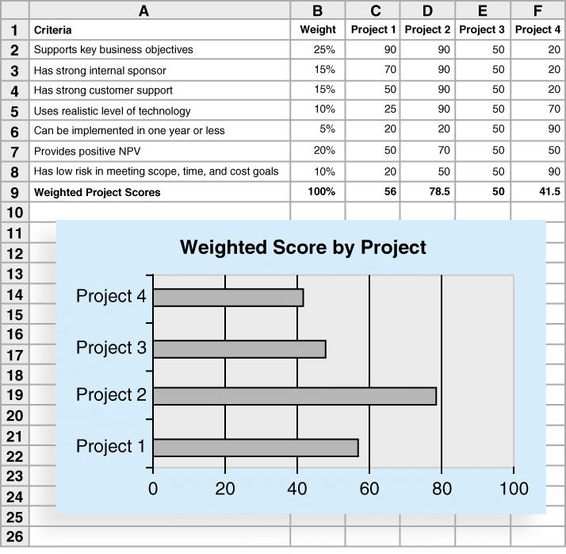
Figure 4-7. Sample Weighted Scoring Model for Project Selection

Slide 37
Implementing a Balanced Scorecard
Drs. Robert Kaplan and David Norton developed this approach to help select and manage projects that align with business strategy
A balanced scorecard
is a methodology that converts an organization’s value drivers, such as customer service, innovation, operational efficiency, and financial performance, to a series of defined metrics
See www.balancedscorecard.org for more information

Slide 38
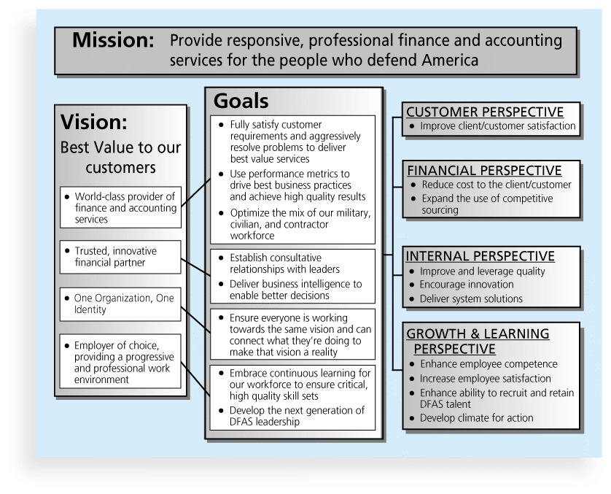
Figure 4-8. Balanced Scorecard Example

Slide 39
After deciding what project to work on the following steps will be performed and mapped with the knowledge areas mentioned at the beginning of the chapter and to be focused on in separate chapters as per PMBOK guidelines and your textbook

Slide 40
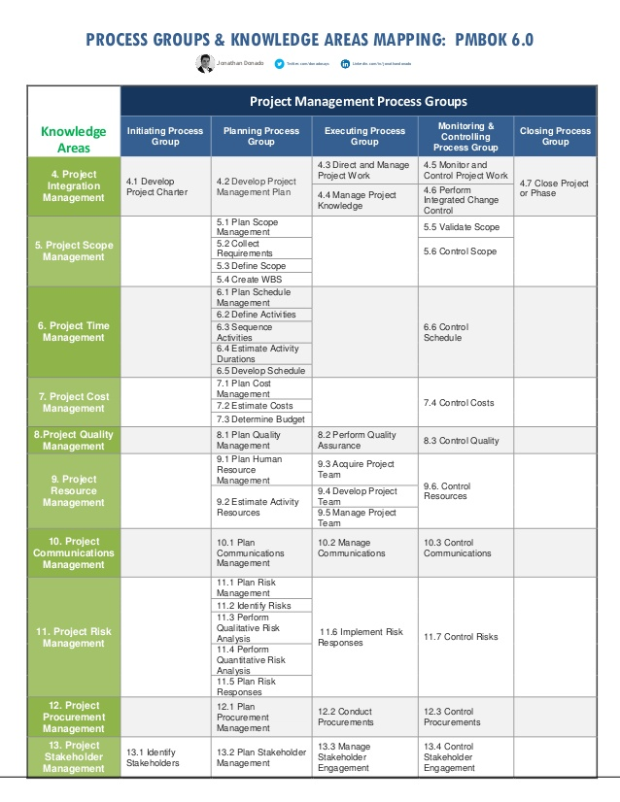

Slide 41
Developing a Project Charter
After deciding what project to work on, it is important to let the rest of the organization know
A project charter is a document that formally recognizes the existence of a project and provides direction on the project’s objectives and management
Key project stakeholders should sign a project charter to acknowledge agreement on the need and intent of the project; a signed charter is a key output of project integration management

Slide 42
Inputs for Developing a Project Charter
A project statement of work
A business case
Agreements
Enterprise environmental factors
Organizational process assets, which include formal and informal plans, policies, procedures, guidelines, information systems, financial systems, management systems, lessons learned, and historical information

Slide 43
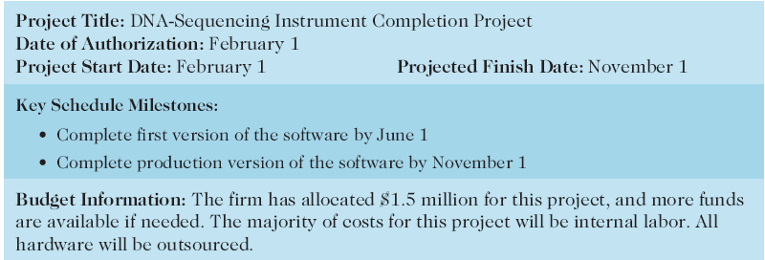
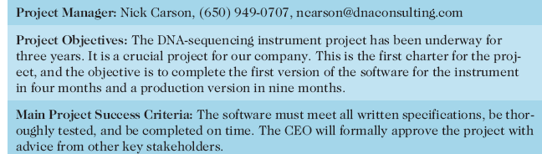
Table 4-1. Project Charter for the DNA-Sequencing Instrument Completion Project

Slide 44
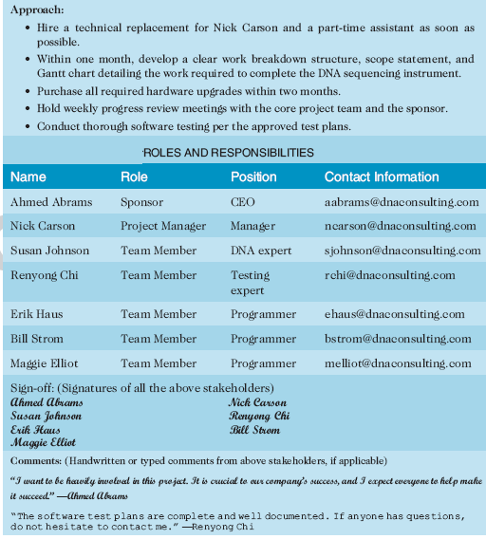
Table 4-1. Project Charter (cont.)

Slide 45
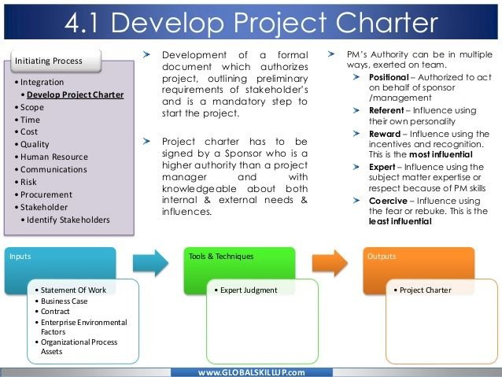
Additional Project Charter Example

Slide 46
Developing a Project Management Plan
A project management plan is a document used to coordinate all project planning documents and help guide a project’s execution and control
Plans created in the other knowledge areas are subsidiary parts of the overall project management plan

Slide 47
Common Elements of a Project Management Plan
Introduction or overview of the project
Description of how the project is organized
Management and technical processes used on the project
Work to be done, schedule, and budget information

Slide 48
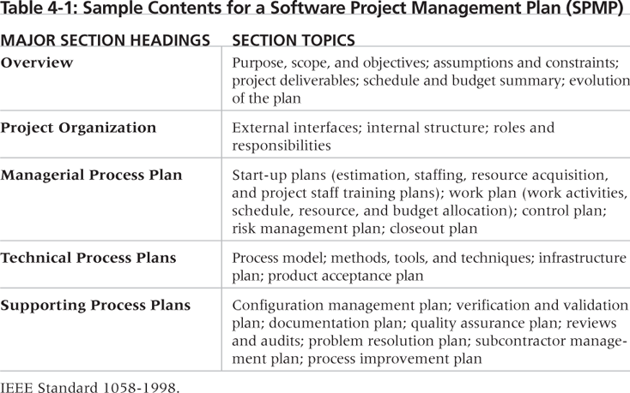
Table 4-2. Sample Contents for a Software Project Management Plan (SPMP)

Slide 49
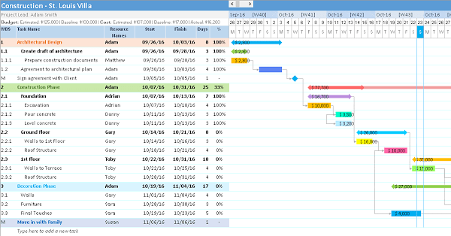
Planning Example

Slide 50
What the Winners Do
"The winners clearly spell out what needs to be done in a project, by whom, when, and how. For this they use an integrated toolbox, including PM tools, methods, and techniques…If a scheduling template is developed and used over and over, it becomes a repeatable action that leads to higher productivity and lower uncertainty. Sure, using scheduling templates is neither a breakthrough nor a feat. But laggards exhibited almost no use of the templates. Rather, in constructing schedules their project managers started with a clean sheet, a clear waste of time.“*
*Milosevic, Dragan and And Ozbay. “Delivering Projects: What the Winners Do.” Proceedings of the Project Management Institute Annual Seminars & Symposium (November 2001).

Slide 51
Directing and Managing Project Work
Involves managing and performing the work described in the project management plan
The majority of time and money is usually spent on execution
The application area of the project directly affects project execution because the products of the project are produced during execution

Slide 52
Coordinating Planning and Execution
Project planning and execution are intertwined and inseparable activities
Those who will do the work should help to plan the work
Project managers must solicit input from the team to develop realistic plans

Slide 53
Providing Leadership and a Supportive Culture
Project managers must lead by example to demonstrate the importance of creating and then following good project plans
Organizational culture can help project execution by
providing guidelines and templates
tracking performance based on plans
Project managers may still need to break the rules to meet project goals, and senior managers must support those actions

Slide 54
Capitalizing on Product, Business, and Application Area Knowledge
It is often helpful for IT project managers to have prior technical experience
On small projects, the project manager may be required to perform some of the technical work or mentor team members to complete the projects
On large projects, the project manager must understand the business and application area of the project

Slide 55
Project Execution Tools and Techniques
Expert judgment: Experts can help project managers and their teams make many decisions related to project execution
Meetings: Meetings allow people to develop relationships, pick up on important body language or tone of voice, and have a dialogue to help resolve problems.
Project management information systems: There are hundreds of project management software products available on the market today, and many organizations are moving toward powerful enterprise project management systems that are accessible via the Internet
See the What Went Right? example of Kuala Lumpur’s Integrated Transport Information System on p. 169

Slide 56
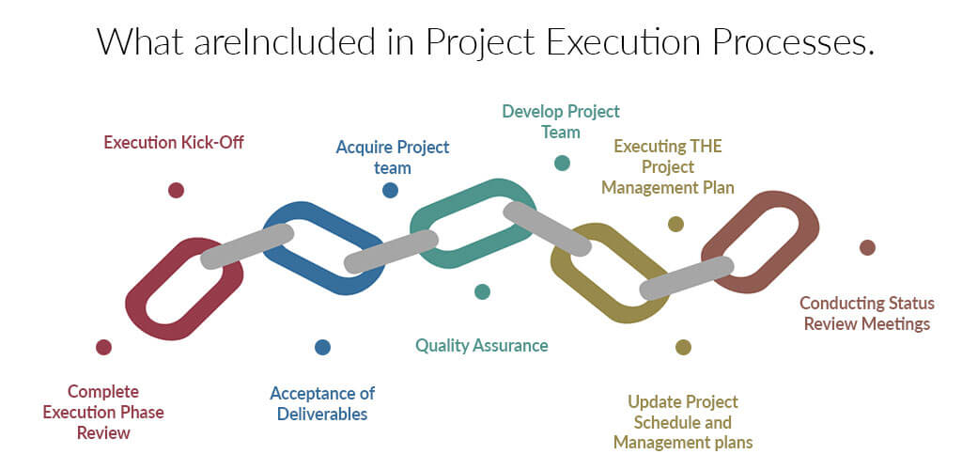

Slide 57
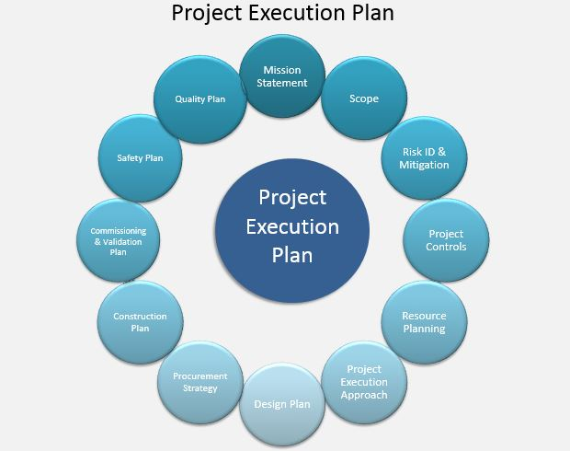
Execution Example

Slide 58
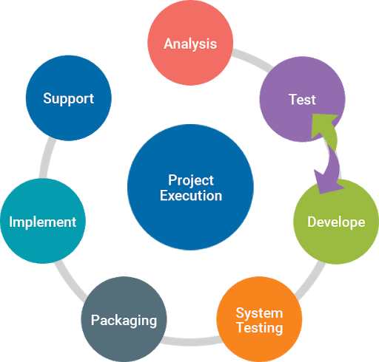
Execution Example (IS Project)

Slide 59
To be Continued Next Lecture

Slide 60
Monitoring and Controlling Project Work
Changes are inevitable on most projects, so it’s important to develop and follow a process to monitor and control changes
Monitoring project work includes collecting, measuring, and disseminating performance information
A baseline is the approved project management plan plus approved changes

Slide 61
Media Snapshot
The 2002 Olympic Winter Games and Paralympics took five years to plan and cost more than $1.9 billion. PMI awarded the Salt Lake Organizing Committee (SLOC) the Project of the Year award for delivering world-class games.
Four years before the Games began, the SLOC used a Primavera software-based system with a cascading color-coded WBS to integrate planning…The SLOC also used an Executive Roadmap, a one-page list of the top 100 Games-wide activities, to keep executives apprised of progress. Activities were tied to detailed project information within each department’s schedule. A 90-day highlighter showed which managers were accountable for each integrated activity.
Fraser Bullock, SLOC Chief Operating Officer and Chief, said, “We knew when we were on and off schedule and where we had to apply additional resources. The interrelation of the functions meant they could not run in isolation—it was a smoothly running machine.”*
*Foti, Ross, “The Best Winter Olympics, Period,” PM Network (January 2004) 23.

Slide 62
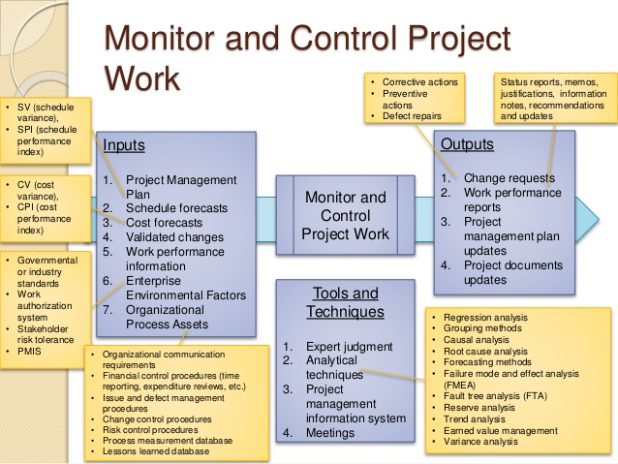

Slide 63
Performing Integrated Change Control
Three main objectives are:
Influencing the factors that create changes to ensure that changes are beneficial
Determining that a change has occurred
Managing actual changes as they occur

Slide 64
Change Control on Information Technology Projects
Former view: The project team should strive to do exactly what was planned on time and within budget
Problem: Stakeholders rarely agreed up-front on the project scope, and time and cost estimates were inaccurate
Modern view: Project management is a process of constant communication and negotiation
Solution: Changes are often beneficial, and the project team should plan for them

Slide 65
Change Control System
A change control system is a formal, documented process that describes when and how official project documents and work may be changed
Describes who is authorized to make changes and how to make them

Slide 66
Change Control Board (CCB)
A change control board is a formal group of people responsible for approving or rejecting changes on a project
CCBs provide guidelines for preparing change requests, evaluate change requests, and manage the implementation of approved changes
Includes stakeholders from the entire organization

Slide 67
Making Timely Changes
Some CCBs only meet occasionally, so it may take too long for changes to occur
Some organizations have policies in place for time-sensitive changes
“48-hour policy” allows project team members to make decisions, then they have 48 hours to reverse the decision pending senior management approval
Delegate changes to the lowest level possible, but keep everyone informed of changes

Slide 68
Global Issues
Rapid changes in technology, such as the increased use of mobile roaming for communications, often cause governments around the world to take action.
Incompatible hardware, software, and networks can make communications difficult in some regions, and a lack of competition can cause prices to soar.
Fortunately, a group called the Organisation for Economic Co-operation and Development (OECD) promotes policies that will improve the economic and social well-being of people around the world.
In February 2012, the OECD called upon its members’ governments to boost competition in international mobile roaming markets.

Slide 69
Configuration Management
Configuration management ensures that the descriptions of the project’s products are correct and complete
Involves identifying and controlling the functional and physical design characteristics of products and their support documentation
Configuration management specialists identify and document configuration requirements, control changes, record and report changes, and audit the products to verify conformance to requirements
See www.icmhq.com for more information

Slide 70
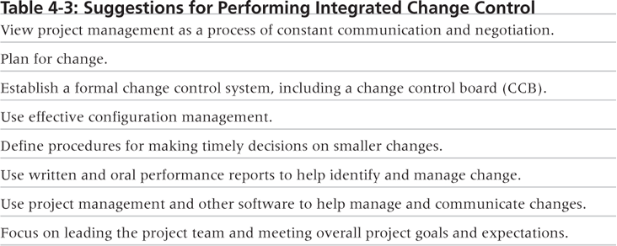
Table 4-3. Suggestions for Performing Integrated Change Control

Slide 71
Closing Projects or Phases
To close a project or phase, you must finalize all activities and transfer the completed or cancelled work to the appropriate people
Main outputs include
Final product, service, or result transition
Organizational process asset updates

Slide 72
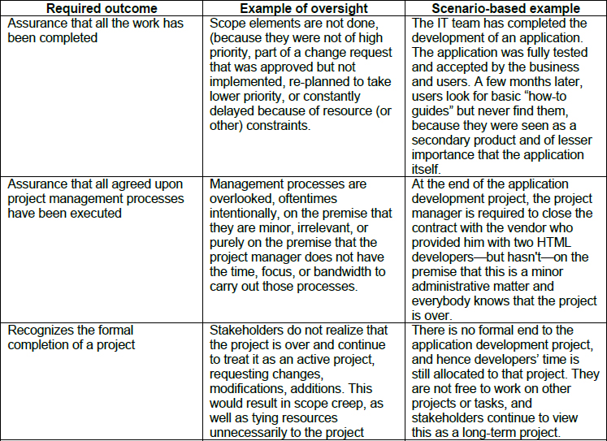
Project Closure Example

Slide 73
Using Software to Assist in Project Integration Management
Several types of software can be used to assist in project integration management
Documents can be created with word processing software
Presentations are created with presentation software
Tracking can be done with spreadsheets or databases
Communication software like e-mail and Web authoring tools facilitate communications
Project management software can pull everything together and show detailed and summarized information
Business Service Management (BSM) tools track the execution of business process flows

Slide 74
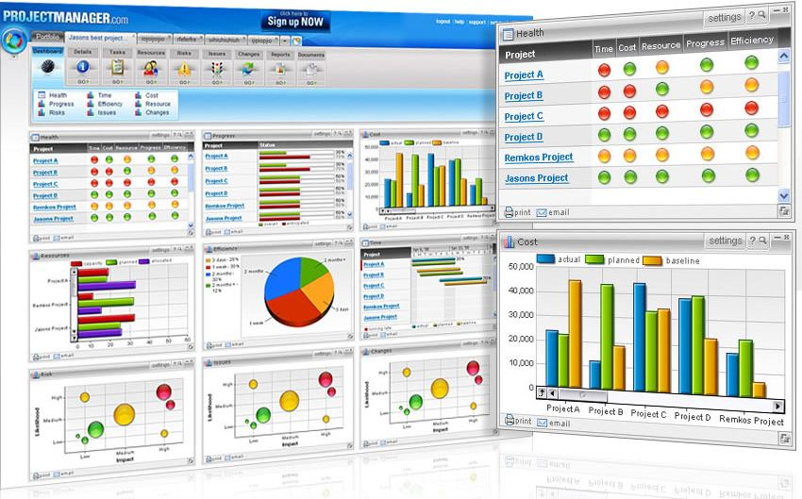
Figure 4-9. Sample Portfolio Management Software Screen
Source: www.projectmanager.com

Slide 75
Chapter Summary
Project integration management involves coordinating all of the other knowledge areas throughout a project’s life cycle
Main processes include
Develop the project charter
Develop the project management plan
Direct and manage project execution
Monitor and control project work
Perform integrated change control
Close the project or phase

